Slide 1


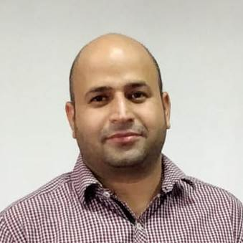
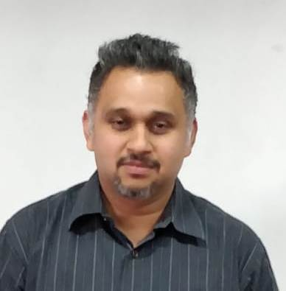


Online Banking by RSA Digital India Initiative
Amit Pandey
Sunil Tikoo
Rohit Durai

Slide 2

Problem Statement
Below are some of the manual processes currently being performed by Traditional banks which can be regularized by making them available online.
KYC compliance
Customer Registration
Account Opening
Beneficiary Mgmt
Fund Transfer
Other Customer Related Services

Slide 3
Use case Diagram

Slide 4
Assumptions and Scope of project
Assumptions
Online account is opened with opening balance of INR 5000
On adding beneficiary account, system is considering that the Account number, Beneficiary Name & IFSC Code are valid.

Slide 5


Technologies
JAVA 1.8
Spring Framework – 4.0.9
Spring Boot 2.1.1
Angular - 7.0
JPA 2.1
JUNIT – 4.9
Oracle 11g
Tools
Eclipse
Visual Studio Code
Postman

Slide 6
Salient features of the System
User Authentication
Simplified Customer Registration
KYC Compliance using Third Party Services
View & Export Account Statement
Online Account Creation
Beneficiary Mgmt
User Password Reset
Email Service

Slide 7
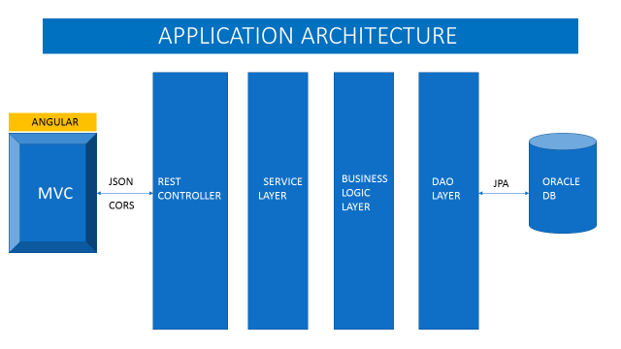
Application architecture

Slide 8

What next? Future plan
Account Mini Statement
Delete Beneficiary
Multiple accounts for Customer
Multifactor Authentication

Slide 9


Application Demo & feedback

Slide 10
Thank you

